Slide 1


Introduction to Microservices Architecture

Slide 2
Agenda
1
2
3
4
5
Introduction
Monolithic hell
Microservice architecture to the rescue
Design principles
Summary

Slide 3

Introduction
What is Microservices Architecture?
Microservices architecture is an approach in which a single application is composed of many loosely coupled and independently deployable smaller services.
Microservices might also be understood by what they are not. The two comparisons drawn most frequently with microservices architecture are monolithic architecture and service-oriented architecture (SOA).

Slide 4


Monolithic Hell
This is fine !

Slide 5
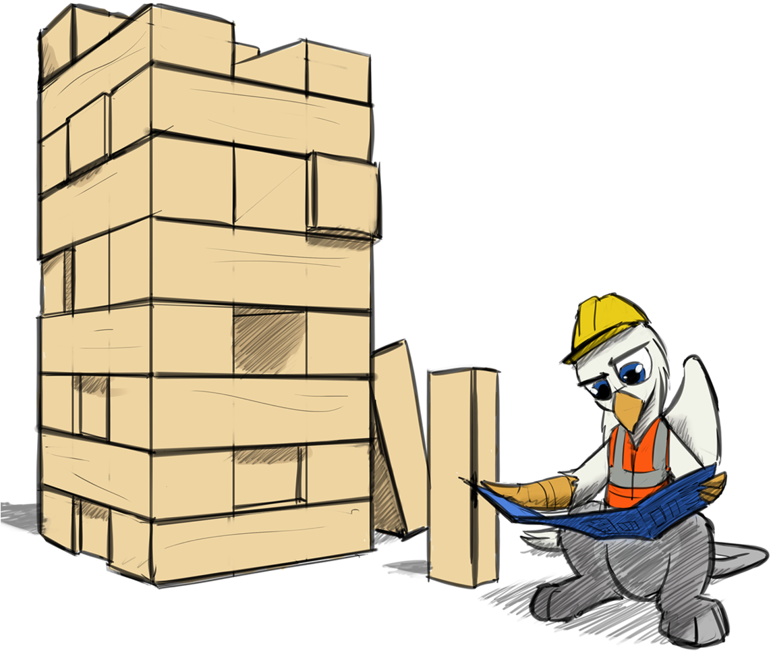
What is Monolithic Architecture
Monolithic is an architectural pattern of designing and developing a complete application as a single unit.
For example, a traditional application will have a frontend, API, services, load balancer, and database. If you build everything together and deploy it on the server, that’s called a monolithic architecture, where services tightly couple together.

Slide 6





Benefits of the monolithic architecture
Simple to develop
IDEs and other developer tools are focused on building a single application
Easy to make radical changes to the application
Straightforward to test
Straightforward to deploy
Easy to scale

Slide 7

Living in a monolithic hell

Slide 8
Monolithic hell
Complexity intimidates developers
Development is slow & it takes long time to add new features
Difficult to scale
Painful to test
Lack of agility and innovation
New releases takes months
Locked tech stack
Frustrated customers

Slide 9
Microservice architecture to the rescue
Microservices architecture (often shortened to microservices) refers to an architectural style for developing applications. Microservices allow a large application to be separated into smaller independent parts, with each part having its own realm of responsibility.

Slide 10
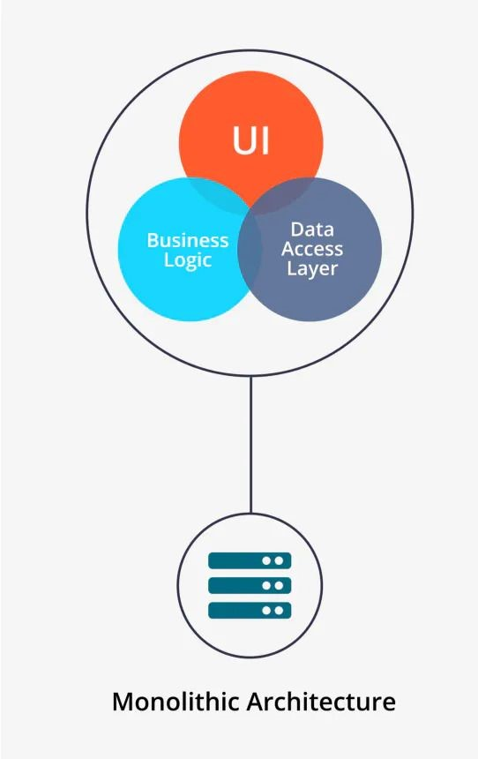
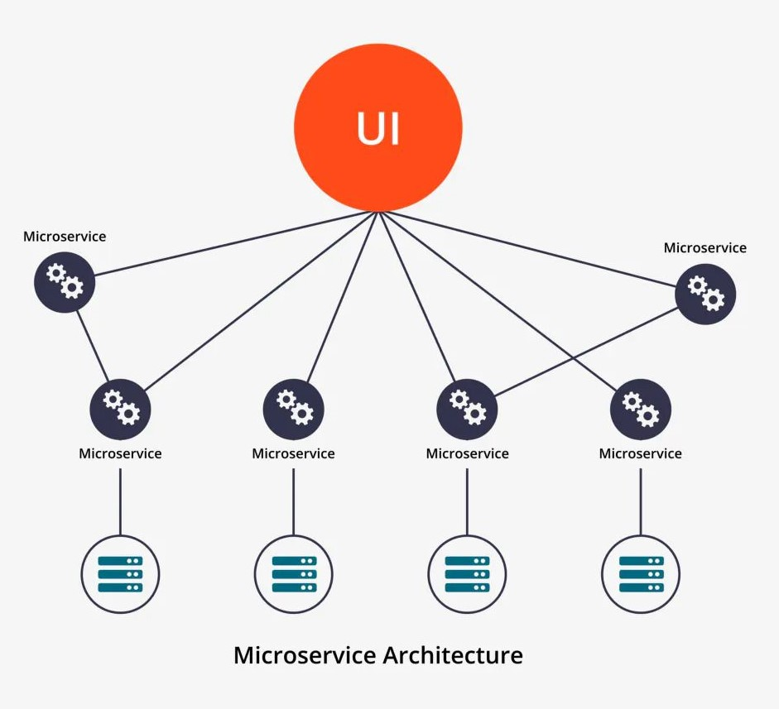
Comparison

Slide 11
Service oriented architecture composed of loosely coupled elements that have bounded contexts.
“
”
Adrian Cockcroft
(former VP of Cloud Architecture @AWS

Slide 12
Why Microservices …
Separation of services 👨‍⚖️
Simple to understand 🤷
Easy to Scale
📐
Reusability of services ♻️
Decentralized data 🌐
Better Fault isolation 🔥🔍
CI/CD 🚅
deployments
No tech stack commitment 💑

Slide 13
Why Microservices …
Easy to maintain
👷🔨
Independently deployable 🏍
Independently Scalable 📐
Comparatively Easy to test 😅
Allows🧪 experimenting and adoption of new technologies
Increased availability ⏳
New features are added quickly 🚀
Teams become autonomous 🦾

Slide 14

Design Principles

Slide 15

Single Responsibility​
One of the SOLID principles​ Do one thing and do it well
The thump rule to apply this principle is: "Gather those things which change for the same reason, Separate those things which change for the different reason".​
Just Don’t Do it

Slide 16


Use the right tool for the job
​With a system composed of multiple, collaborating services, we can decide to use different technologies inside each one. This allows us to pick the right tool for each job, rather than having to select a more standardized, one-size-fits-all approach
Define domain specific use cases; embrace and adopt various frameworks

Slide 17
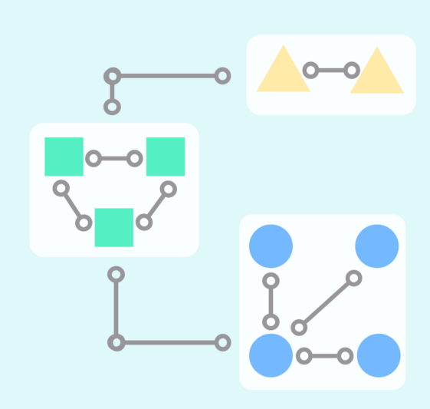
Highly cohesive and Loosely coupled​
Develop the microservices based on distinct features with zero overlap with other functions.
​The main objective is to reduce the interaction between services
If we separate the functionality across wrong boundaries will lead tight coupling and increased complexity between services.

Slide 18
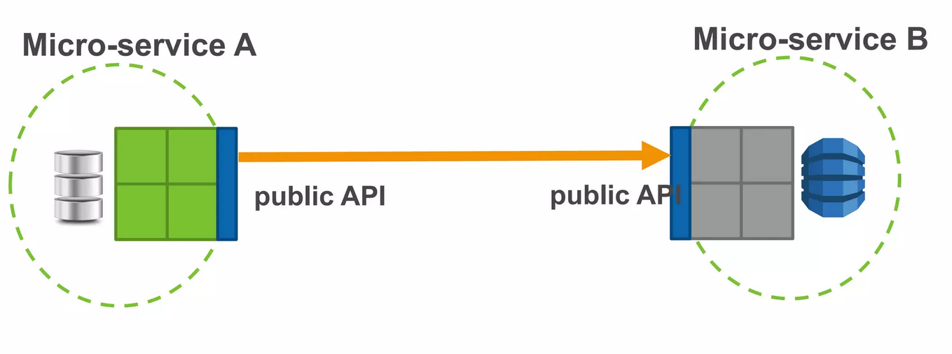
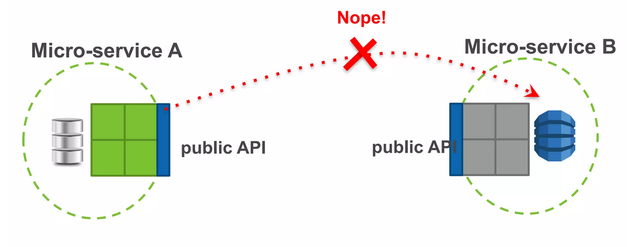
Intercommunication​
Services communicate using either synchronous or ​asynchronous protocols
Services only rely on each others public API’s
Hide your data

Slide 19
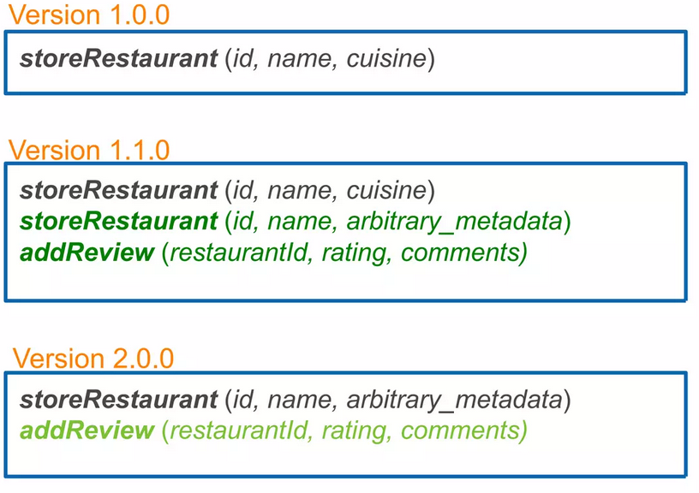
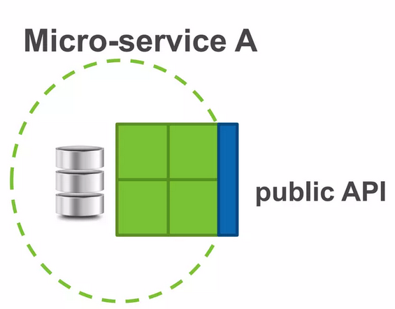
Intercommunication…​
Evolve API in backward compatible way.
Document API properly

Slide 20


Summary

Slide 21


Thank you

